Slide 1
NZISM/NZOHNA CPD Day
Outline
Introduction
Pasifika People in New Zealand – cultural values that impact engagement
Mental Health Challenges
The concept of the ‘va’ & a NZ context
Pacific Youth Leadership And Transformation
CHARITABLE TRUST
pylatcouncil@gmail.com |0273303244

Slide 2
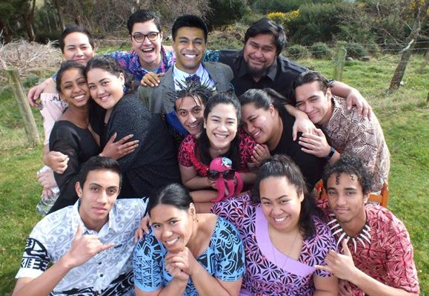
PYLAT Council
Our Vision
A world well informed and influenced by Pacific Youth.
Our Mission
To empower Pasifika young people to participate in all worlds
Notes:
This presentation is the intellectual property of the Pacific Youth Leadership and Transformation Trust. PYLAT asks that this not be published or shared with out permission. Please contact us at pylatcouncil@gmail.com

Slide 3
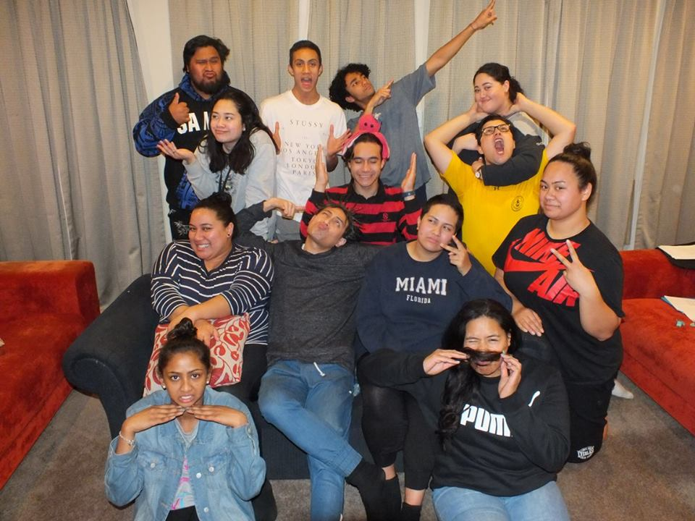
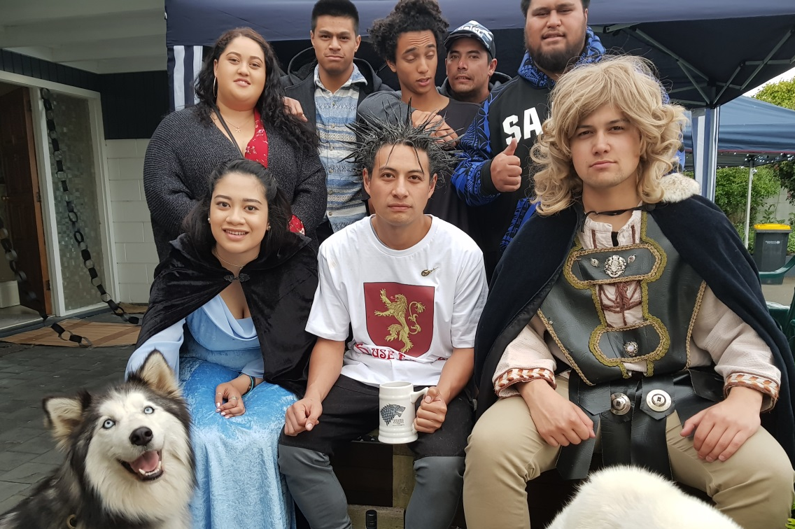
What we do
Sit on boards and advisory groups, deliver workshops.
Represent Pasifika in the Canterbury Youth Sector
Our own projects

Slide 4
Pacific Youth Parliament:
Our Movement

Slide 5
Statistical Overview

Slide 6
Pasifika Snapshot in NZ
 | Pasifika | European | Maori
National Population (2018) | 8.1 % (382k) | 70.8% (3.33 mil) | 16.5% (776k)
Canterbury Population (2018) | 3.1% (19k) | 82.3% (494k) | 9.3% (56k)
Median Age (2018) | 23 | 41 | 25
Median Income (2013) | $19,700 | $30,900 | $22,500
NCEA University Entrance (MOE 2018) | 62.3% | 77.5% | 58.1%
NZ Census Data

Slide 7
Health Snapshot
All adult figures (15+) | Pasifika | European | Maori
Diabetes | 12.2% | 4.9% | 7.8%
Diagnosed Asthma | 8.8% | 13% | 17.5%
Current smokers | 22.9% | 13.5% | 33.5%
Adult Obesity | 65% | 30.7% | 47.5%
Ministry of Health: NZ Health Survey 2017/18

Slide 8
What is Pasifika?

Slide 9
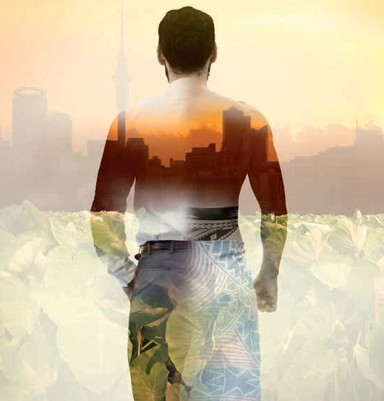
Pasifika?
Being ‘Pasifika’ is still relatively unclear. Somethings to keep in mind:
There is still debate over whether it should be Pacific, Pasefika, Oceanian etc.
In Samoa you are Samoan, in Tonga you are Tongan, when you come to New Zealand you fall into ‘Pasifika’.
There is a growing population of Fijian Indian’s and Chinese Samoan’s who are born in the Pacific. This further confuses things.
Le Va ‘s Absolute Acceptance Photo

Slide 10
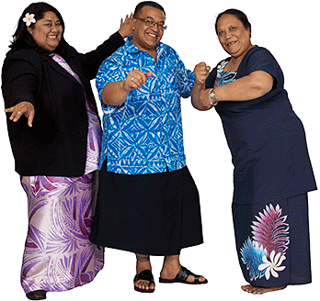
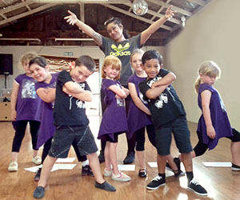
Pasifika?
The Pacific population consists of:
Island born
First generation, second generation, third and fourth etc.
Multiple ethnicities.

Slide 11
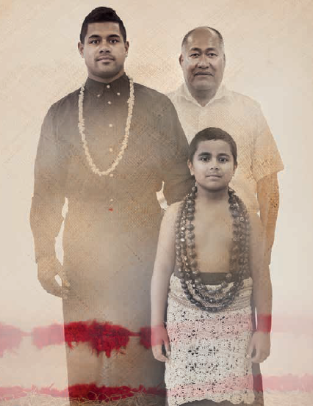
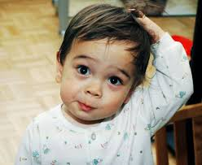
So what does it all mean?
The Pacific population is diverse in challenges and needs, examples:
Language barriers
Limited traditional knowledge, big belongingness issue:
Belongingness
What does this mean for 1st generation who don’t fit in in their island nor in New Zealand?
Le Va ‘s Photo

Slide 12
Independence
Equality
Freedom of expression
Inter-dependence
Hierarchy
Respect
Notes:
Indendent health seeking behaviour
Access what you are entitled to
Know what you are allowed to ask for, and that it is okay to express it

Slide 13
Mental Health
New Zealand has the highest rates of suicide for young people in the OECD
Pasifika young people have the highest attempts of Suicide in New Zealand than any other group.
Suicide is the leading cause of death for Pasifika males. More than car accidents.
Le Va – FLO Talanoa Training

Slide 14
Mental Health
New Zealand Medical Journal – 28 April 2017
Pacific People higher rates of scoring in the ‘high Kessler risk range’ of mental health.
Pacific people had low diagnosis rates and were less likely to be seeking help.
Pacific Young people 3 times more likely to attempt suicide.
Pacific Suicide rates were highest amongst 15 – 24 year olds and lowest amongst 40+.
Direct opposite to total New Zealand where 15 – 24year olds were the lowest rate, and 40+ were the highest.

Slide 15
Mental Health & the workplace
The panel heard about need for workplace education about mental health and wellbeing. It was highlighted that mental health supports "rarely extend to assisting people to maintain work or, return to work”. (page 53)
People who shared with the Inquiry wanted workplace suicide prevention training, and for wellbeing protective factors to be enhanced. (page 37).
Some people told the panel they wanted their colleagues to be able to recognise and respond well to mental distress and addiction challenges in all workplaces (page 61)

Slide 16
Mental Health & the workplace
Some submitters told the panel that it wasn’t possible to recover from the stigma of mental health, once sharing your diagnosis at work (page 93).
The Inquiry Panel acknowledged that many organisations fund a limited number of free counselling sessions. But if employees cant access this, or pay for private support, support can be inaccessible. (page 109)
The inquiry report stated that well workplaces are an essential part of addressing poor outcomes, and promoting wellbeing (page 144)
Notes:
- Not in the report, but maybe particularly in caring professions there is an opportunity to support each others well-being more, and getting unions to focus on this as well as safe staffing levels, and time off etc. Peer support learning and connection time.
Clinical workforce
Cultural workforce
Peer workforce

Slide 17
Mana Moana, Dr Karlo Mila
How did Pacific indigenous knowledge interpret ‘Mental Illness’?
The answer lies in languages and proverbs
Overwhelmingly “arofa, ofa, alofa, aloha” or ‘love’ is used to explain mental health.
Dr Karlo Mila
Notes:
The inquiry endroses this, and Dr Karlo Mila actually did the pacific submission summary of the inquiry

Slide 18
Mana Moana, Dr Karlo Mila
"aro’a atu, aro’a mai” – ‘atu’ away or to give.
‘Mai’ to receive.
When the ‘va’ is healthy it is flowing. ‘Va’ is the relational space between us.
Blockages can occur from negativity.
The result of negative ‘va’ can be ill health
Dr Karlo Mila
Notes:
Essentially what it means to be well is that you are able to give and receive love.

Slide 19
The va in the workplace
Dr Karlo Mila
Notes:
Essentially what it means to be well is that you are able to give and receive love.

Slide 20
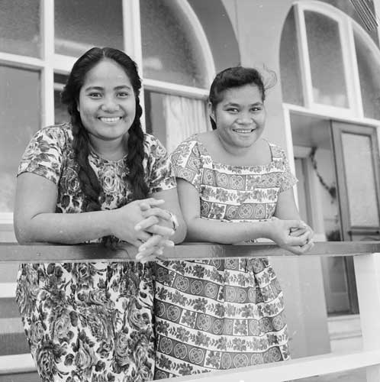
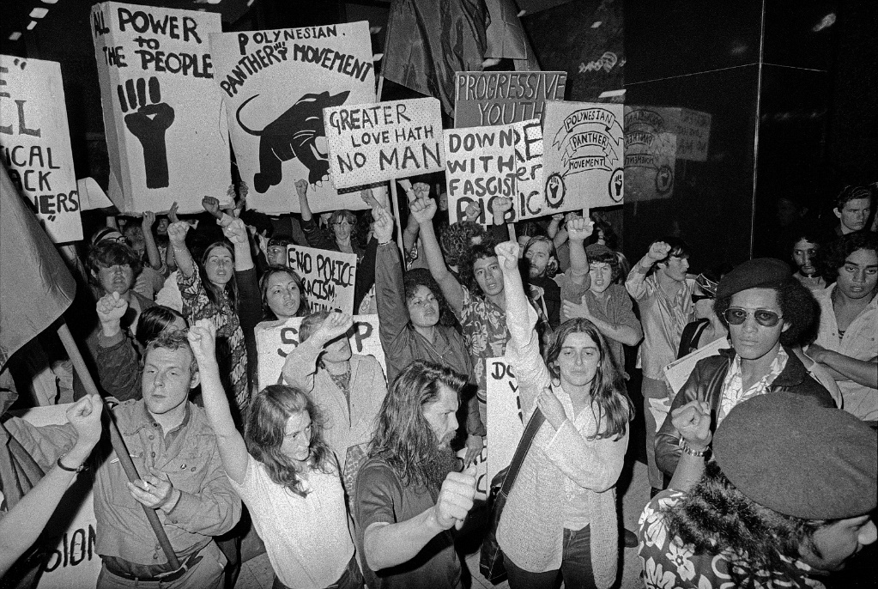
History of the ‘va’ and Pacific people in NZ
The va flowed in the 1950’s when Pasifika peoples were welcomed into employment in NZ to fill the labour shortage
A blockage in the va occurred in the 1970’s and 80’s when the jobs became scarce and Pasifika people were targeted in the Dawn Raids.

Slide 21
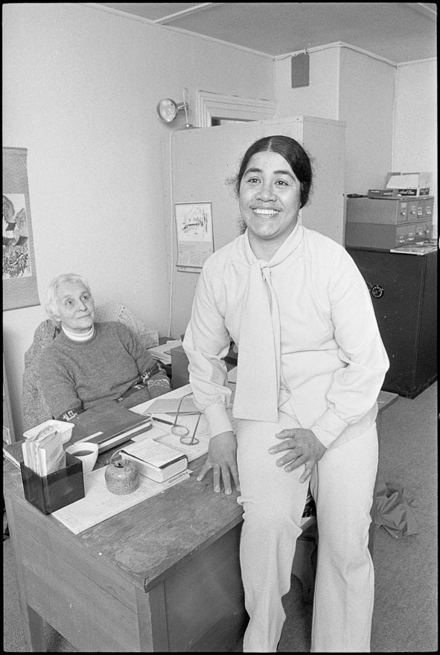
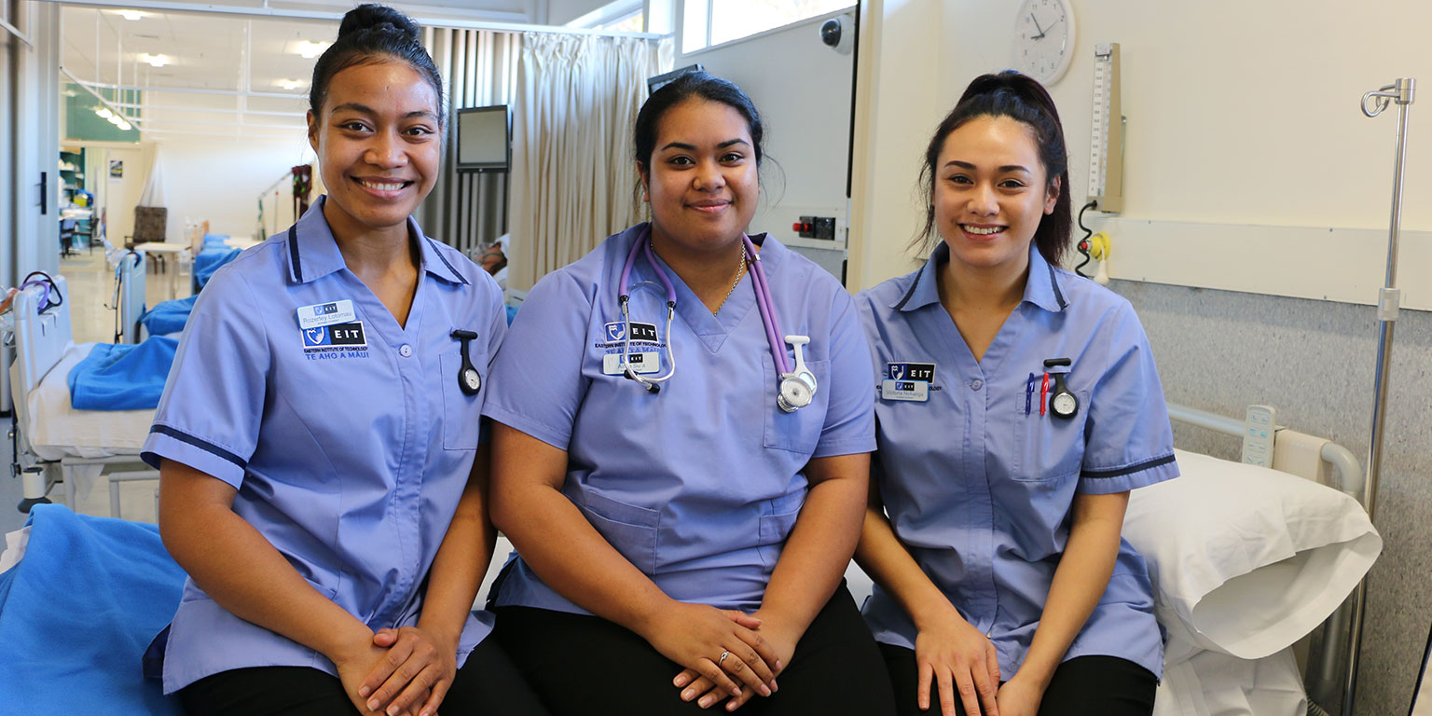
History of the ‘va’ and Pacific people in NZ
In 1982 the Privy Council declared that in 100,000’s of Samoan’s were NZ citizens.
The government quickly reversed this.
Since, a number of initiatives have been created to help Pasifika people close gaps and find work in New Zealand beginning to re-establish the va
Notes:
Vai Niu – 3 pages which talks about pacific well being and particularly a way to incorporate this into the workplace.

Slide 22
Close
Thanks for having me!
Notes:
This presentation is the intellectual property of the Pacific Youth Leadership and Transformation Trust. PYLAT asks that this not be published or shared with out permission. Please contact us at pylatcouncil@gmail.com

